Slide 1
Zotero

Slide 2
Metadata
Gives us context for the information
Those contexts are created by people
Metadata is an interpretative decision
Black Lives Matter Library of Congress Subject Heading

Slide 3
When Do You Use Metadata
Grocery Store
Library
Movie Store
Any others?

Slide 4
Doyle, Arthur Conan. “A Scandal in Bohemia.” Sherlock Holmes: Selected Stories. Ed. Barry McCrea. Oxford: Oxford University Press, 2014. Print. Oxford World’s Classics.
Notes:
What is this? A citation yes.
But also metadata

Slide 5
Sherlock Holmes Metadata
Book Section
Author: Doyle, Arthur Conan
Title: A Scandal in Bohemia
Book: Sherlock Holmes: Selected Stories
Editor: Barry McCrea
Location: Oxford
Publisher: Oxford University Press
Date: 2014
Format: Print
Series: Oxford World’s Classics.

Slide 6
Doyle, Arthur Conan. “A Scandal in Bohemia.” Sherlock Holmes: Selected Stories. Ed. Barry McCrea. Oxford: Oxford University Press, 2014. Print. Oxford World’s Classics.
Notes:
How would they describe their relationships with citations like these? Terrible? How do they go about putting them together?
By hand? Anyone use Easybib or some other citation manager?
Why?
We’re going to think about how these work. It’s also a formula. And if we know the fomula for putting together a citation, we can then replicate it just from the metadata.
And what have we learned – METADATA IS EVERYWHERE.

Slide 7
Citations are a Formula
Author. Title. Book. Editor. Location: Publisher, Data. Format. Series.

Slide 8
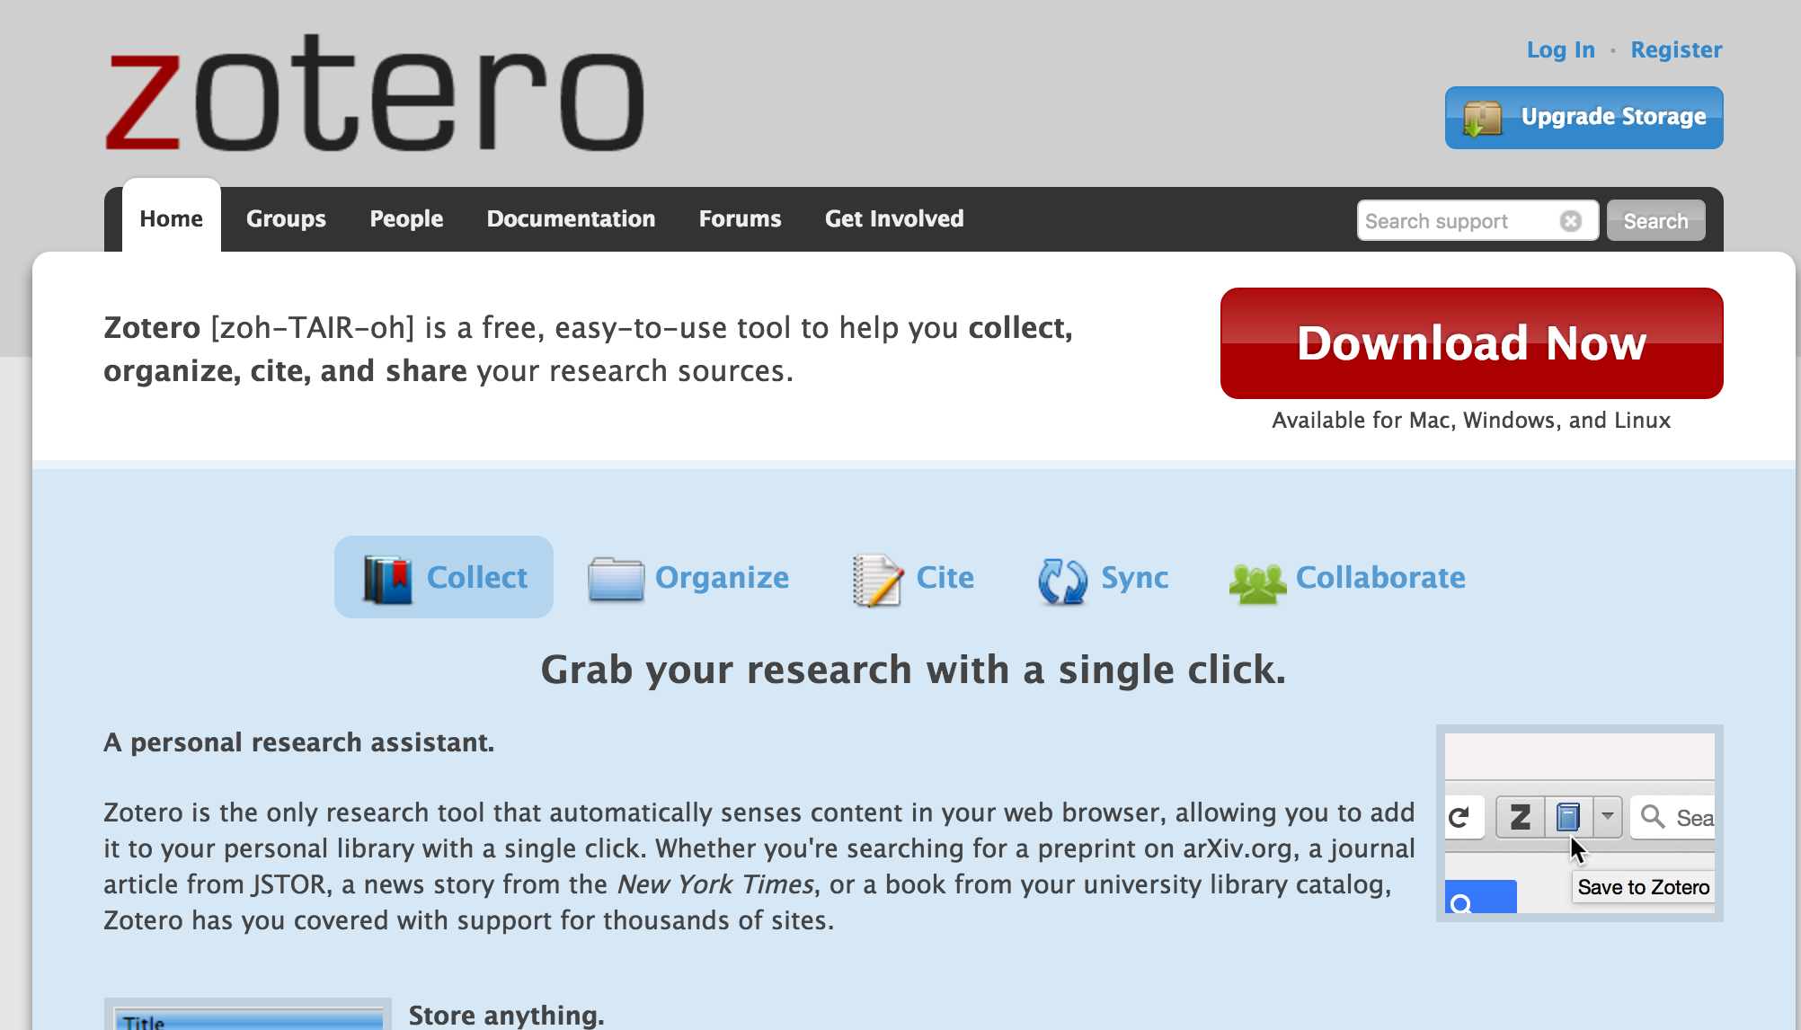
Zotero
https://www.zotero.org/
Notes:
Click the download button

Slide 9
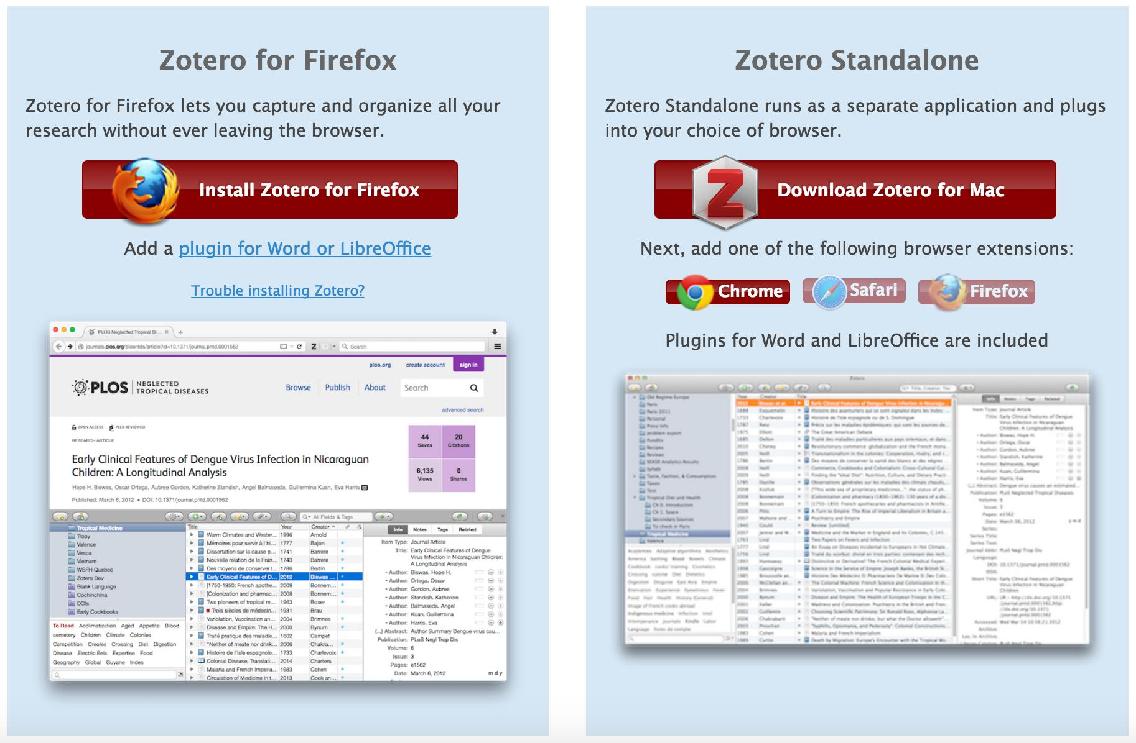
Notes:
Download zotero standalone. Runs out of firefox, but standalone is handy to have. Also download whatever browser extensions for the browsers you use.

Slide 10
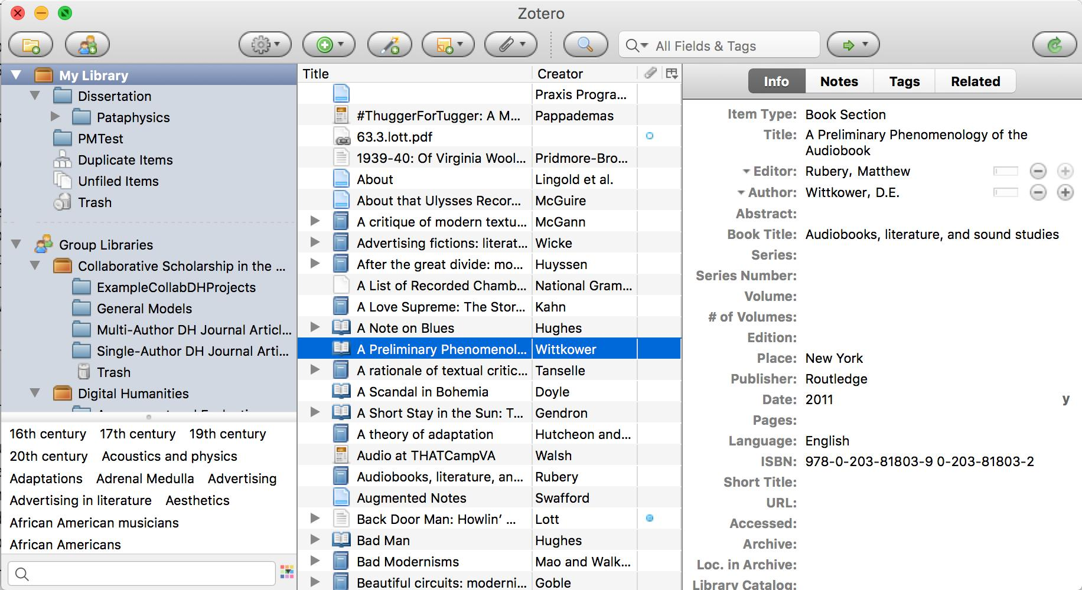
Notes:
Walk through the various elements. It collects all the different items that you work with for your research.
Metadata on the right.
Items in the middle
Organize your research on the left.
Basically today is about helping them help themselves.

Slide 11
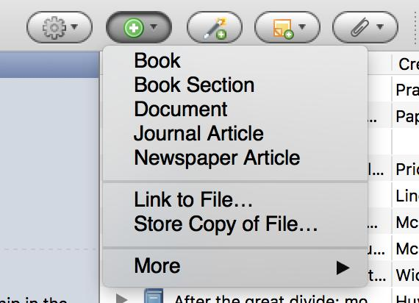
First way – Enter Manually
Pull up the Amazon page for Rosalind Crone's Violent Victorians.
Add a book.
Enter the metadata

Slide 12
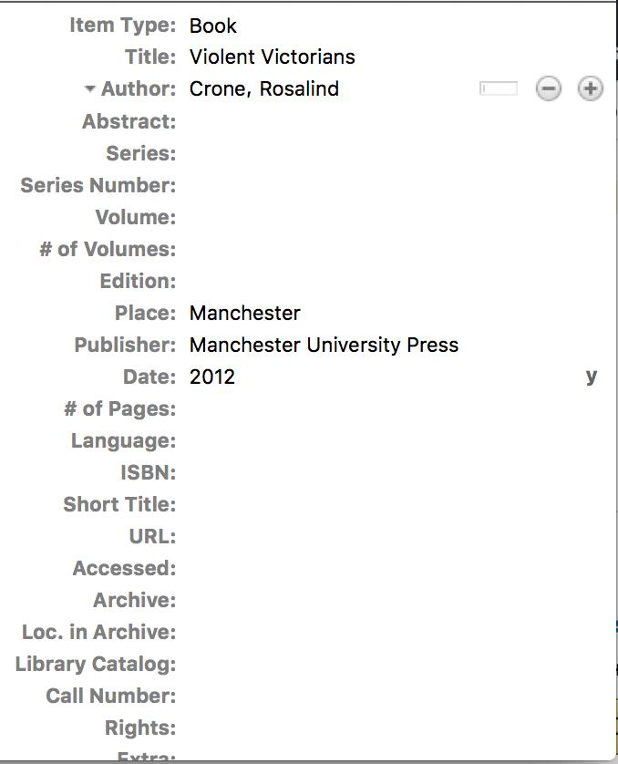
Notes:
Everyone have something like this?
Zotero now knows about our citation. But there are two other ways to enter data.

Slide 13
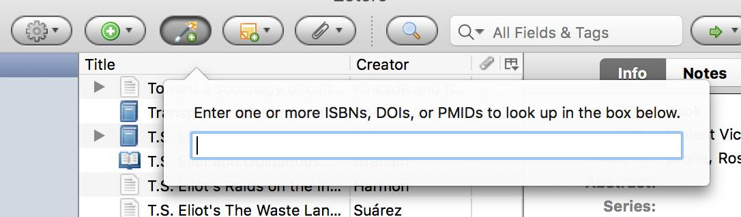
Second Way - ISBN
Find and enter the ISBN for Spectacular Realities by Vanessa Schwartz
Notes:
What is an ISBN?
International Standard Book Number (ISBN)
Like a social security number for a book. If we know that they’re meant to be unique, we could theoretically pull the info for that book, right? Zotero can do that!

Slide 14
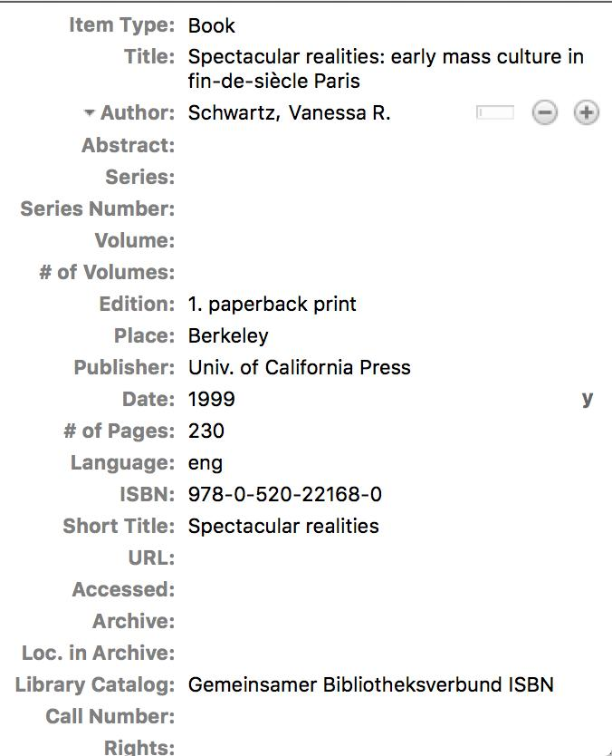
Notes:
Everyone get something like this? Any comments about it? Looks a little messy! We might need to clean up parts of it. Look at the title, for example.

Slide 15

Third Way – Web Scraping
Visit Amazon Page for Sara Baartman and the Hottentot Venus: A Ghost Story and a Biography
Click the Zotero looking button in your web extensions
Notes:
There is actually hidden metadata behind a lot of the pages you see on the internet. Remember TEI? Contextual information that often gets hidden from people? Zotero works on the basis of something called COinS metadata.
You don’t see it, and it usually doesn’t affect your life. But that metadata is there, hiding and waiting to be used. Zotero can scrape it, or pull it down for you to work with.

Slide 16
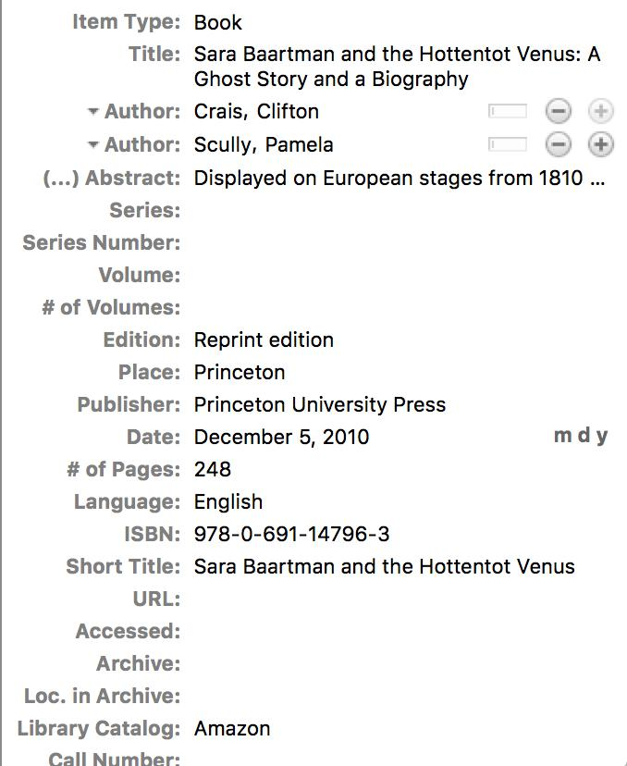
Notes:
Garbage in Garbage out. This has to be cleaned up! Not going to get rid of everything, but it will help.

Slide 17
Now…Magic
Who uses Microsoft Word?
What versions?
Any other kind of text editing software?
Might cause problems, but we can sort them out!
First, go to Zotero > Preferences > Cite > “Install Microsoft Word Add-in”
Second, open Microsoft Word
Notes:
Note:
If they’re using something other than Word 2011, I’d suggest just following as I go through to see what we’re trying to do. Then Sarah and I can get you sorted after.
Doing this step adds a zotero menu to every microsoft word document that you open. Let’s open one to see

Slide 18
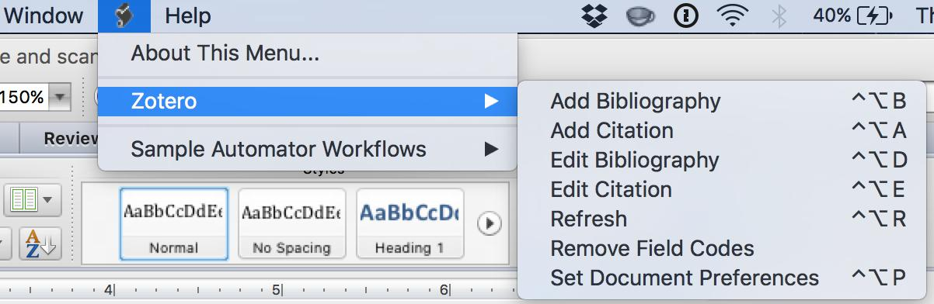
Notes:
Look here is our new menu with lots of options!
First let’s type an example sentence out in our document.
Go to the menu and click Add Citation – the first part of the process.

Slide 19
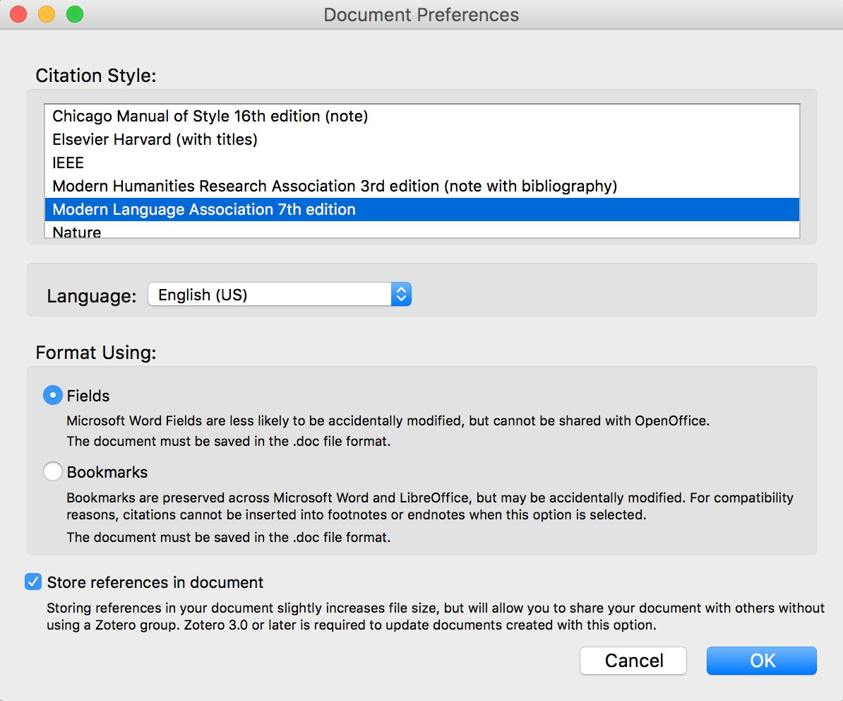
Notes:
Pulls up this. We’re going to click MLA because I’m turning you all into English majors.
Hit accept

Slide 20
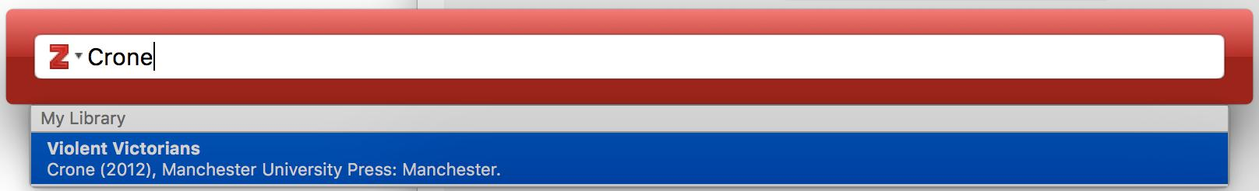
Notes:
Will bring up this menu. Typing part of your metadata will bring it up. Let’s do Crone.

Slide 21
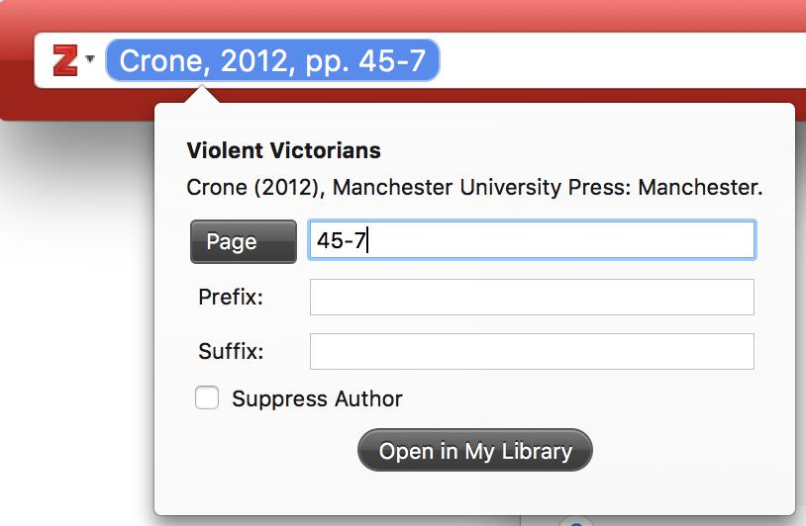
Notes:
Click the citation to bring up more options. Let’s add some page numbers. Hit return.

Slide 22
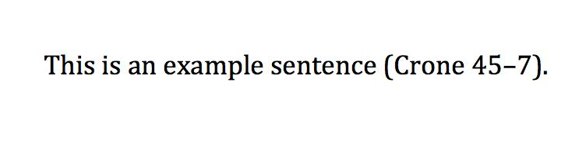
Notes:
Look! Magic! Zotero will spit the citation out for you all formatted.

Slide 23
Keyboard Shortcuts
'ctrl + option + a' will add a new citation.
'arrow keys' allow you to highlight particular objects from the Zotero search when inputting a citation
'return' selects a particular citation.
'cmd + down arrow' will bring up additional options like adding page numbers once you have a citation selected in the add citation input field.

Slide 24
Adding a Bibliography
From the Zotero menu > “Add Bibliography”
Add a few more citations.
Note how they automatically update.

Slide 25
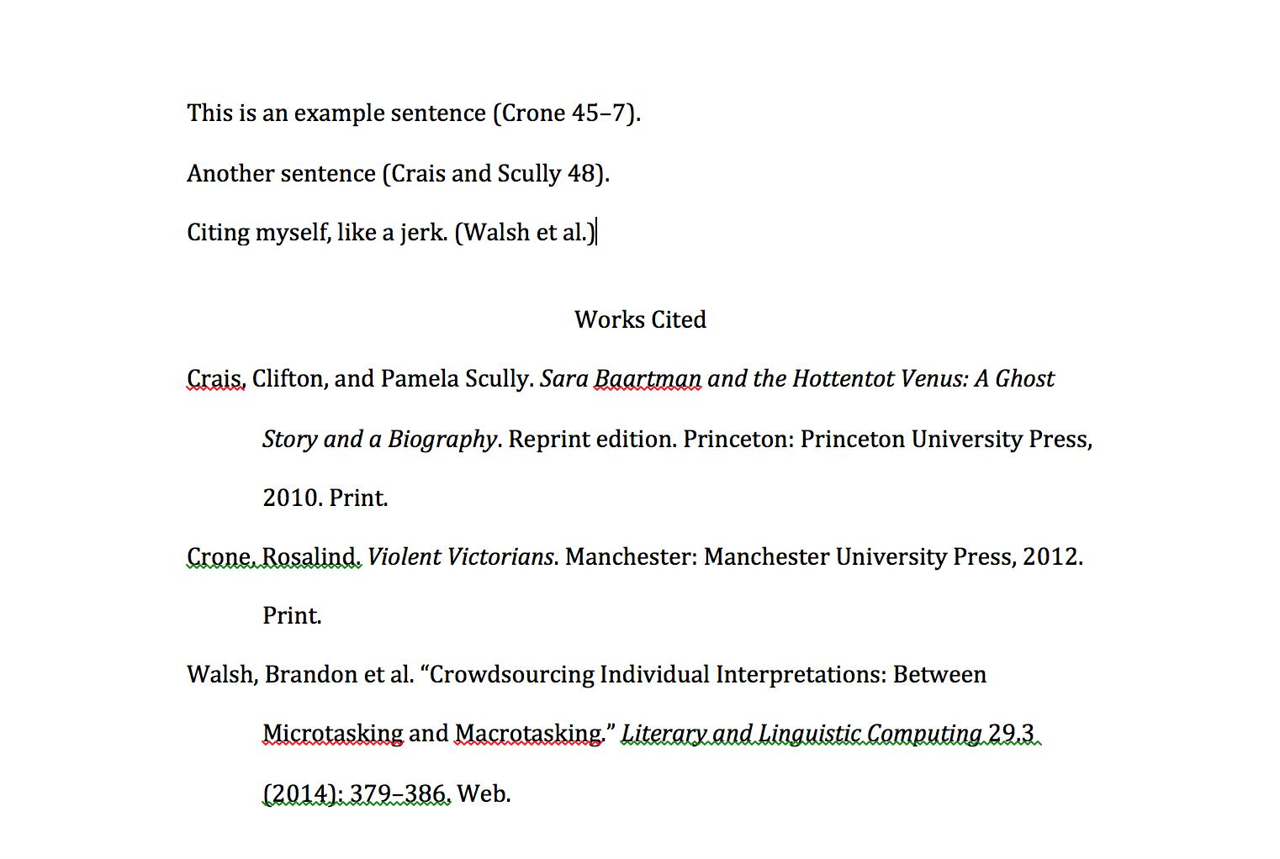
Notes:
Keep working until you get something like that.

Slide 26
Open Access – usually refers to research materials
Open Source – refers to software.
Code is available.
Anyone can add to it.
Community of people working on a product for the public good.
Contrast with something like Microsoft Word, which only the people at Microsoft can work on.

Slide 27
Zotero Groups
https://www.zotero.org/search/type/group
https://www.zotero.org/groups/digital_humanities
Zotero collects and shares your bibliographies.
Groups are a way to distribute resources among others.
Like a personalized, public library.
Notes:
Open Source mentality pervades all parts of Zotero

